Slide 1



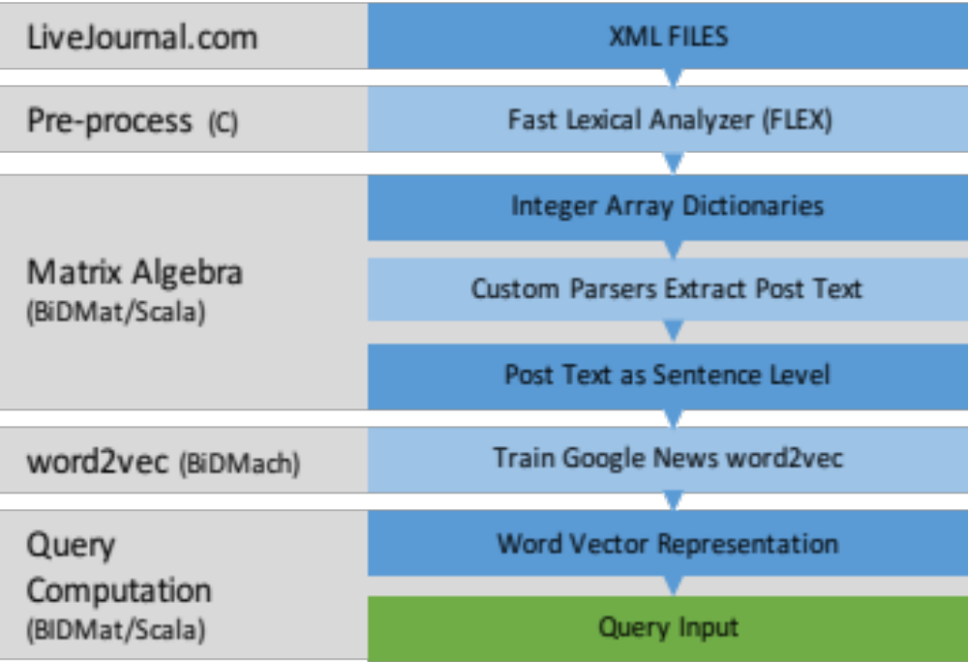
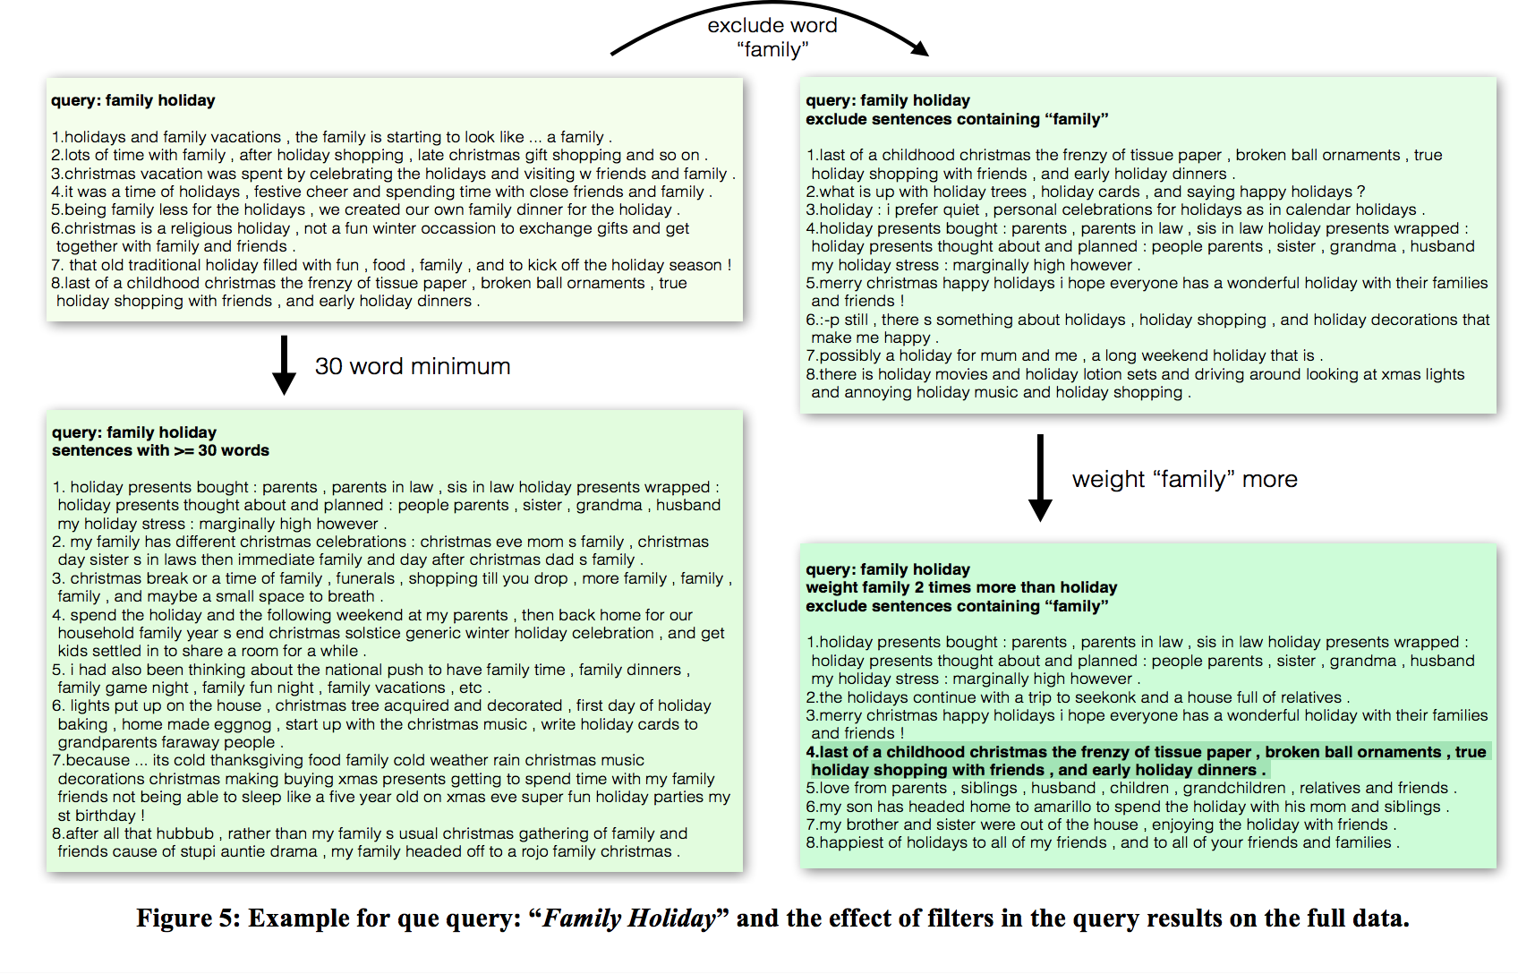
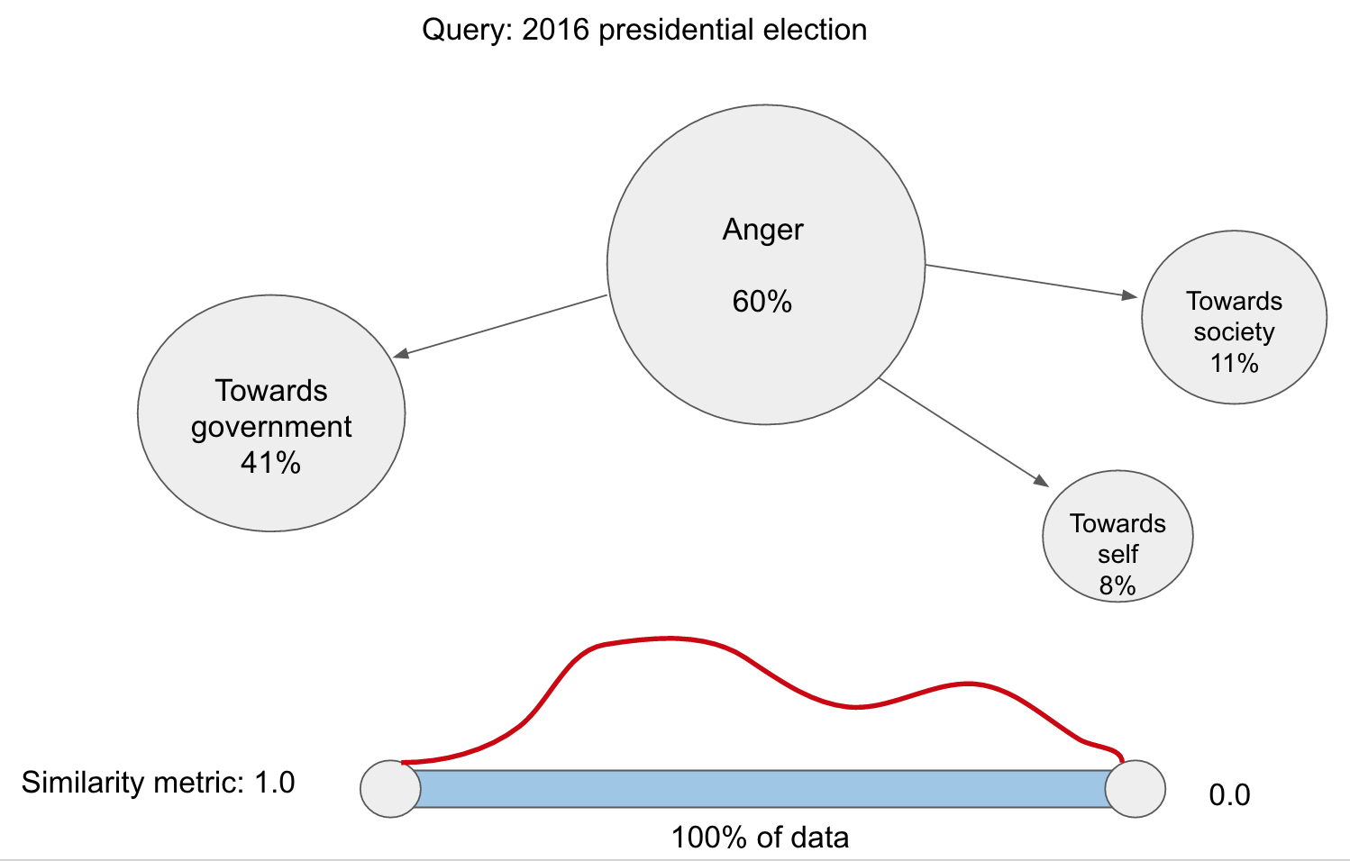
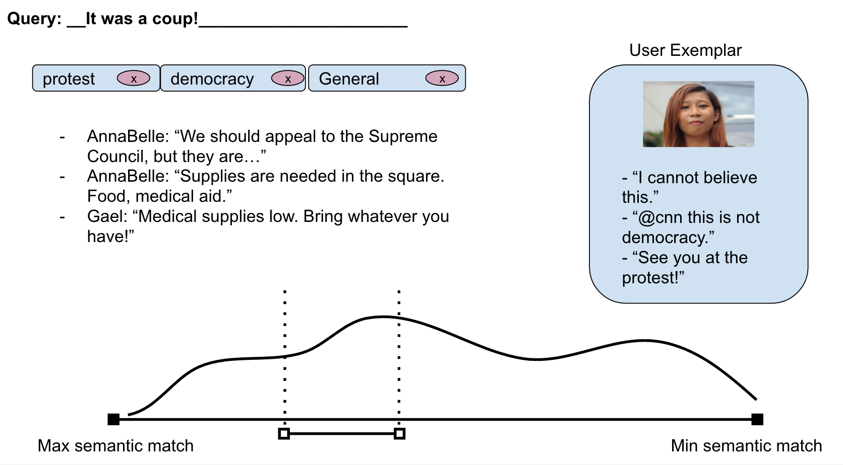
Berkeley Institute of Design
INQUIRE Tool: Early Insight Discovery for Qualitative Research
Main Objective
Develop a tool that allows researchers in the Social Sciences to search over millions of users’ records to drive early insights that are conducive to the formulation of research strategies or even theories.
Work in Progress
Building a web application in preparation for a presentation at CSCW 2017.
Data collection for enriching our existing dataset.
Exploring ways of visualizing and presenting findings to the end user.
Future work
Hierarchical clustering to be able to use 100% of the data we have collected.
Exploring new datasets and new ways different groups can utilize our tools.
Pipeline
System Components:
BidMat/BidMach: Scala API optimized for large-scale sparse matrix and machine learning computations used to parse data and to generate the cosine similarity calculations.
LiveJournal Dataset: Social media site where users maintain an anonymous personal, publicly accessible online journal or diary, with themes including diverse areas such as health, lifestyle, hobbies, and others.
Word2vec Algorithm: recurrent neural network algorithm used to train word embeddings which enables us to search for semantically similar expressions. For example, while searching for “illness” you can find expressions such as “My chest hurts”.
Google News Embeddings: carries information that links more formal (journalistic) writing with colloquial personal expressions.
Figure 1: Inquire’s main system components
Main takeaways from interviews with users
Researchers found themselves running multiple queries with incremental variations many times.
Many wanted to see the surrounding sentences or the post related to the sentence they were interested in.
They valued the process of developing queries and claimed that it helped them become a “smart user” and formulate new ideas on the topic.
Some appreciated seeing many expressions similar to the query as well as others semantically close but syntactically different.
One interviewee claimed that the tool helped him a lot in finding “genres” of users.
Human Computer Interaction
Currently in the process of prototyping how to best help users explore a large corpus of text data
Team: Pablo Paredes, Vasilis Oikonomou, Pierre Karaschuk, Biye Jiang, Elena Glassman ,Terrie Yang, Frankie Guerrero
In collaboration with Prof. John Canny , Prof. James Landay, Coye Cheshire
BIDS Facilitators: Dav Clark, Anthony Wai

Slide 2
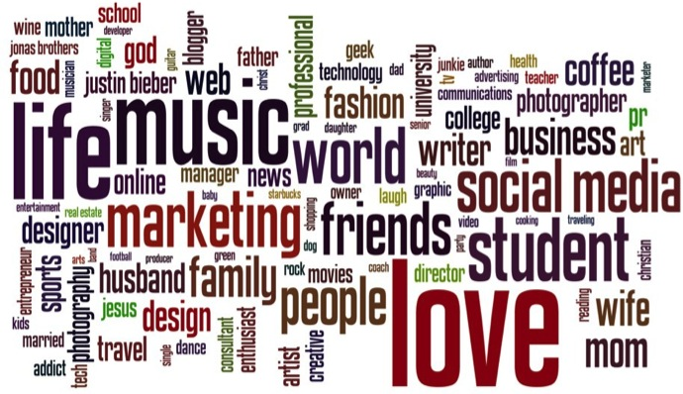
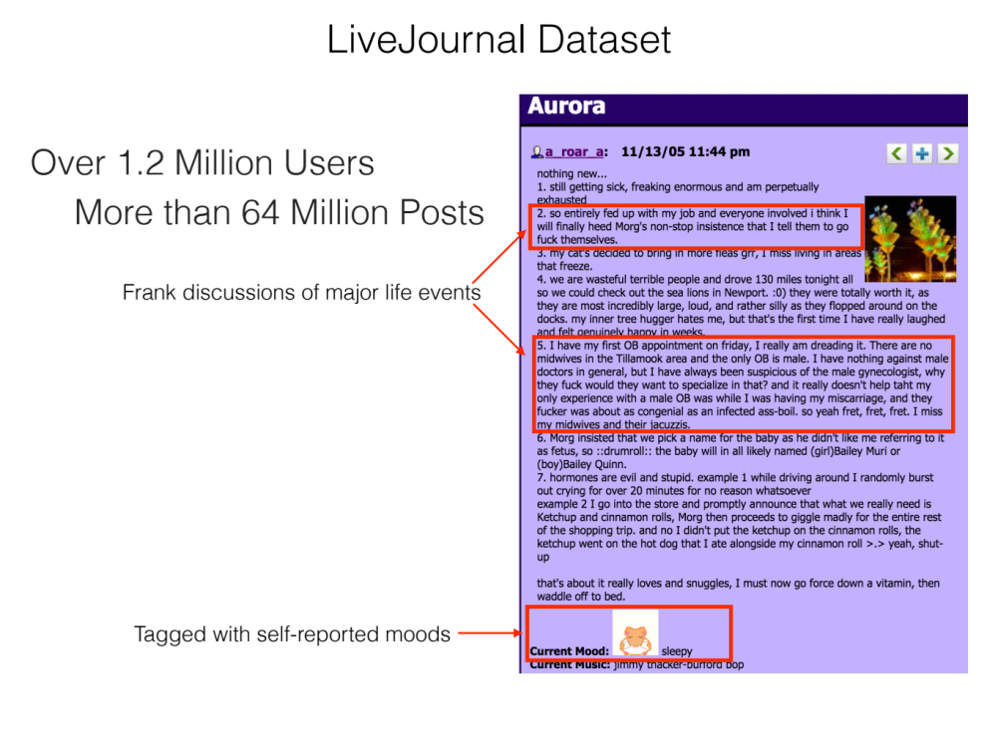
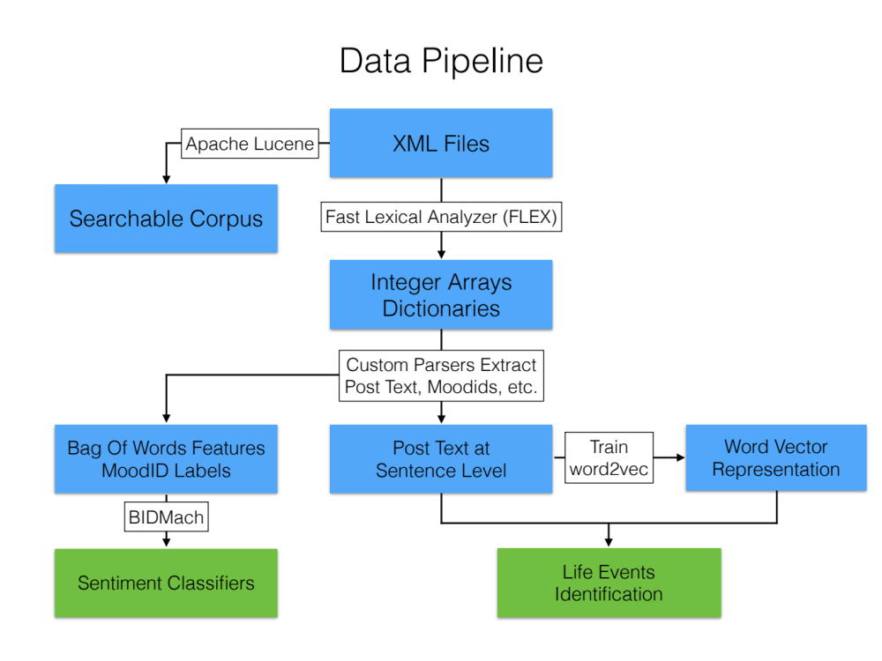

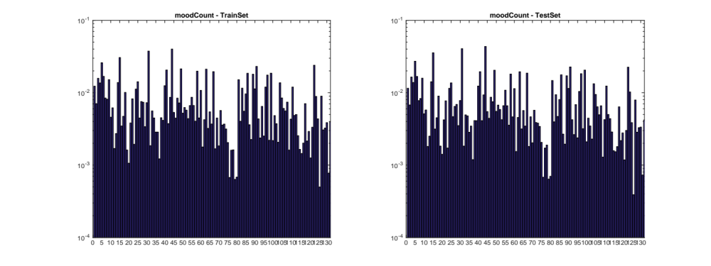
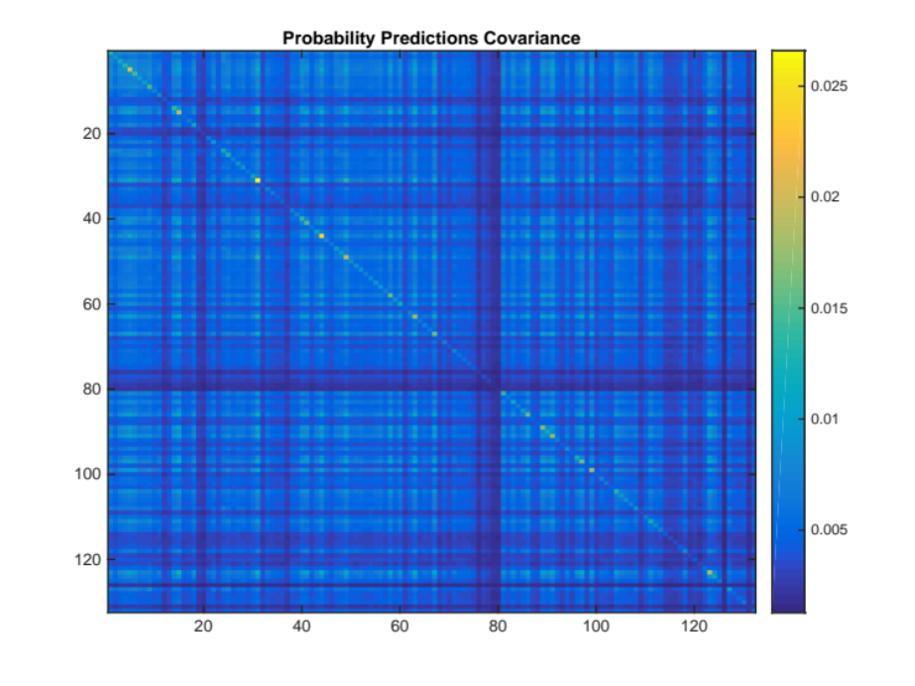
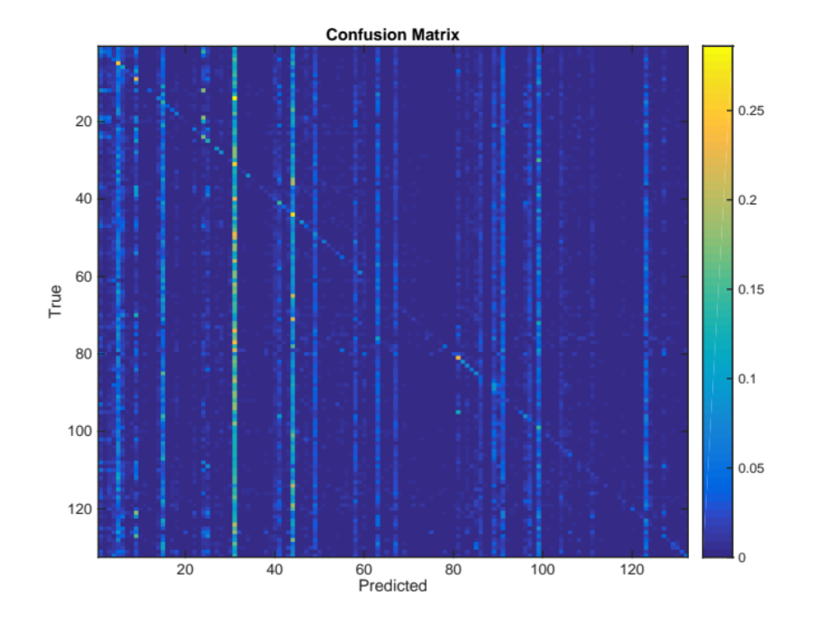
Berkeley Institute of Design
DeStress Mining Stress Meaning from Social Media
Main Objective
Identify causes, interventions and archetypes for stress and well being
Work in Progress
Succesful word2vec semantic querying for advanced featurization
Re-training classifiers with post-level randomization
Future Work
PCA reduction to 6 universal emotions (discrete emotion classification) → ICA reduction to 2 fundamental dimensions (dimensional emotion classification)
Mechanical Turk automated query result selection for LiveJournal word2vec
Causal inference between Life Events Questionnaire (LEQ) features and stress/mood labels
Data Wrangling
Post data:
Colloquial, incomplete, cryptic, misspelled, personal/anonymous
Labeling
50% of posts tagged by users with a mood tag
Labels: 132 moodID number representing emotions such as: “happy, “cranky”, “frustrated”, etc.
Features: Bag of words of each post
Classifier: Logistic Regression with L1 regularization
BIDMach: CPU and GPU-accelerated Machine Learning Library
Results: 60% mean Area Under the Curve
Conclusion: Hard task:
i) Too many moodIDs (several are synonyms – not orthogonal);
ii) Post content is very noisy (html, misspellings, slang, etc.)
Potential Solution: Dimensionality reduction (PCA/ICA) & better features (word2vec)
Advanced Featurization
Theory: Life Events Questionnaire (LEQ): Clinical tool with 79 questions about chronic and acute (positive and negative) stress events.
Challenge: Discover LEQ content within post data (colloquial).
Learning Model: Word2Vec - Semantic word representation into vectors vec(“king”) – vec(“man”) + vec(“woman”) = “Queen”
Model 1: Google News corpus - 300 dimensional
- Reordered vector to match our dictionary → word2vec * dictionary
- Two iterations: 1) Single Word/Phrase → 2) Handpicked Phrases
Model 2: Custom model trained on LiveJournal dataset + user IDs
- Gensim / 300-dimensional / typos, colloquialisms, etc.
- Add user IDs every 3 words → different semantics per user
1st Iteration – Single word/phrase
scala> query("illness", 5)
0.705 -- and attempting to sleep of illness .
0.683 -- did you suffer illness or injury ?
0.680 -- sickness !
0.670 -- they may fake terminal illness , pregnancy , or disease .
0.652 -- my mother who fell ill to a mental illness twice .
2nd Iteration – Handpicked Phrases
scala> multi_query(illness_queries, 7, true, 2)
0.632 -- my father was diagnosed with cancer in early june lung cancer that has spread to the bones .
0.628 -- my mom is in the hospital with a kidney infection .
0.628 -- my brother is sick with bronchitis .
0.625 -- i went to the doctors , and i ended up having double ear infections and really bad strep throat .
0.623 -- he passed away last thursday due to complications with bronchitis in connection to a rare lung disease .
Team: Pablo Paredes, Cory Schilaci, Ana Ferreira, Gene Yoo, Pierre Karaschuk, Dennis Xing, In collaboration with: Daniel Seita, Prof. John Canny BIDS Facilitators: Dav Clark, Anthony Wai

